Slide 1

Inheritance and Polymorphism
MTS 2
OOP - Java Programming

Slide 2
Outline
Inheritance
The super keyword
Constructors and Inheritance
Method Overriding
Override annotation (@Override tag)
protected Access Modifier
final modifier
Abstract Classes
Interfaces
Dynamic Method Binding

Slide 3
Inheritance
Is a form of software reuse in which a new class is created by absorbing an existing class’s members and embellishing them with new or modified capabilities.
This means that you can create a new class simply by indicating the ways in which it differs from a class that already has been developed and tested.
When you create a class by making it inherit from another class, the new class automatically contains the data fields and methods of the original class

Slide 4
Inheritance
With inheritance, you can save time during program development by basing new classes on existing proven and debugged high-quality software.
This also increases the likelihood that a system will be implemented and maintained effectively
The existing class is called the superclass, and the new class is the subclass
Superclass is also called base class or parent class
Subclass is also known as derived class or child class
Each subclass can be a superclass for future subclasses

Slide 5
Inheritance
Inheritance is also known as specialization due to the fact that subclass exhibits the behaviors of its superclass and can modify those behaviors so that they operate appropriately for the subclass
The direct superclass is the superclass from which the subclass explicitly inherits.
An indirect superclass is any class above the direct superclass in the class hierarchy, which defines the inheritance relationships between classes.
In Java, the class hierarchy begins with class Object (in package java.lang), which every class in Java directly or indirectly inherits from.

Slide 6
Inheritance
Java supports single inheritance, meaning each class is derived from exactly one direct superclass.
Inheritance is represented by is-a relationship
an object of a subclass can also be treated as an object of its superclass—e.g., a car is a vehicle
Composition is represented by has-a relationship
an object contains as members references to other objects— e.g., a car has a steering wheel

Slide 7
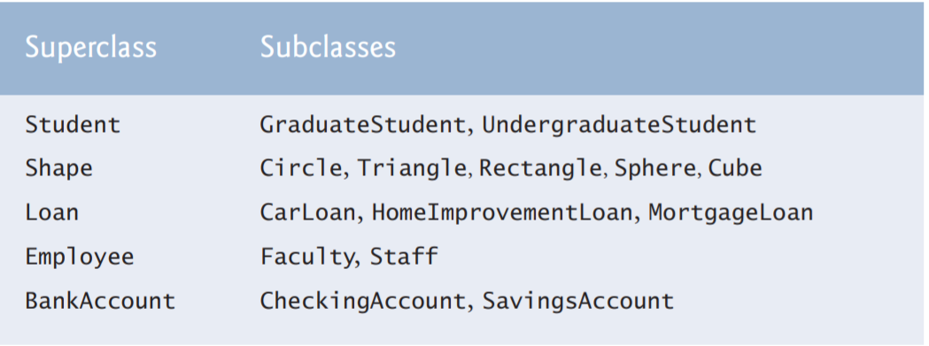
Inheritance
With inheritance, an object of one class is also an object of another class. i.e. an object of subclass is also an object of superclass.

Slide 8
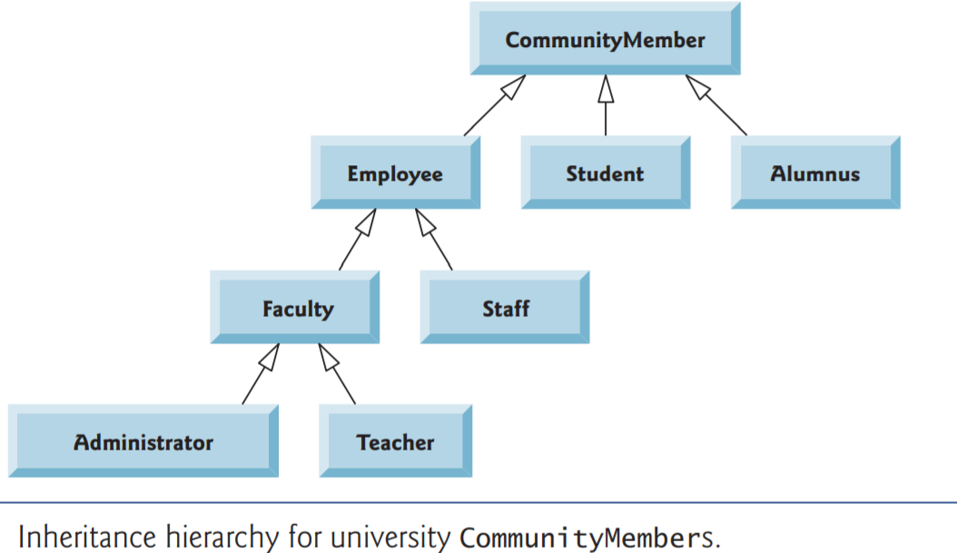
Inheritance

Slide 9
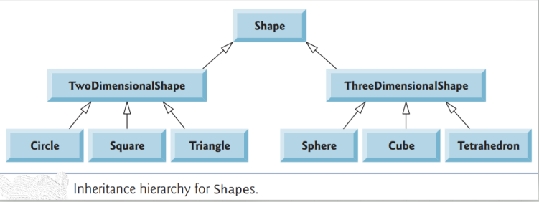
Inheritance

Slide 10
Inheritance
Java uses extends keyword for inheritance
Suppose we have two classes Parent (superclass) and Child (subclass), then we use extends as follows:
public class Parent{
//members omitted
}
public class Child extends Parent{
//members omitted
}

Slide 11
Inheritance
Example – accessing inherited members
public class Parent{
public void display(){
System.out.println(“Inherited from Parent”);
}
}
public class Child extends Parent{
//no methods
}
...

Slide 12
Inheritance
Please note that private members are not inherited.
...
public class Main{
public static void main(String[] args){
Child c = new Child();
c.display();
}
}

Slide 13
The super Keyword
The super keyword is used to:
Call the superclass constructors - can be used for initializing data members
Call superclass methods - similar way we use the this reference
The super statement to call superclass constructor should be the first statement in the subclass constructor.
//Superclass constructor
public Parent(int id, String name){
this.id = id;
this.name = name;
}

Slide 14
The super Keyword
If the names of superclass members have been shadowed by subclass members, we can use super to refer to superclass members. We illustrate on the next slide
//Subclass constructor
public Child(int id, String name, String x){
super(id,name);
this.x = x;
}

Slide 15
The super Keyword
//Methods in the Child class
public void message(){
System.out.println(“From Child”);
}
public void display(){
message(); //this call method from subclass
super.message(); //calls method from superclass
}

Slide 16
Constructors Execution Order
In a class hierarchy, constructors complete their execution in order of derivation, from superclass to subclass.
Further, since super( ) must be the first statement executed in a subclass’ constructor, this order is the same whether or not super( ) is used.
If super( ) is not used, then the default constructor of each superclass will be executed.

Slide 17
Method Overriding
When a method in a subclass has the same name and type signature as a method in its superclass, then the method in the subclass is said to override the method in the superclass.
When an overridden method is called from within its subclass or from object of the subclass, it will always refer to the version of that method defined by the subclass.
The version of the method defined by the superclass will be hidden
Method overriding is used to achieve runtime polymorphism in Java. We will see this later.

Slide 18
Method Overriding
//Methods in the Superclass, Parent
public void display(){
System.out.println(“From Superclass”);
}
//Methods in the subclass, Child
public void display(){
System.out.println(“From Subclass”);
}
//In main() method of Main class
Child c = new Child();
c.display(); //displays From Subclass

Slide 19
Override Methods
The three types of methods that you cannot override in a subclass are:
static methods
final methods
Methods within final classes

Slide 20
Override Annotation (@Override)
When you override a parent class method in a child class, you can insert an override annotation just prior to the method.
The override annotation lets the compiler know that your intention is to override a method in the parent class rather than create a method with a new signature
/*If no method from superclass matches this one *the compiler will throw an error */
@Override
public void display(String msg){
}

Slide 21
Final Modifier
Methods and classes can be declared with final modifier
The final modifier in a method indicates that the method cannot be overridden.
Normally, Java resolves calls to methods dynamically, at run time. This is called late binding.
However, since final methods cannot be overridden, a call to final method can be resolved at compile time. This is called early binding

Slide 22
Final Modifier
//Method in the Superclass, Parent
public final void display(){
System.out.println(“From Superclass”);
}
/*Method in the subclass, Child
*This throws an error because display was declared as *final in superclass
*/
public void display(){
System.out.println(“From Subclass”);
}

Slide 23
Final Modifier
The final modifier used in a class declaration indicates that the class cannot be inherited
Declaring a class as final implicitly declares all of its methods as final, too.
It is illegal to declare a class as both abstract and final since an abstract class is incomplete by itself and relies upon its subclasses to provide complete implementations

Slide 24
Final Modifier
//Method in the Superclass, Parent
public final class Parent{
//members omitted
}
/*
*Inheritance below throw an error because the Parent *class was marked as final, hence cannot be inherited
*/
public class Child extends Parent{
//members ommited
}

Slide 25
Abstract Classes
Data abstraction is the process of hiding certain details and showing only essential information to the user.
Abstraction can be achieved with either abstract classes or interfaces
Abstract class
A class that is declared as abstract;
it cannot be instantiated,
it may (or may not) include abstract methods.
An abstract method is one declared as abstract and has no implementation
Concrete class:
A class that is not declared as abstract;
each of its methods must have an implementation.

Slide 26
Abstract Classes
Here are the rules about abstract methods and the abstract classes that contain them
Any class with an abstract method is automatically abstract itself and must be declared as such. To fail to do so is a compilation error.
An abstract class cannot be instantiated.
A subclass of an abstract class can be instantiated only if it overrides each of the abstract methods of its superclass and provides an implementation
If a subclass of an abstract class does not implement all the abstract methods it inherits, that subclass is itself abstract and must be declared as such.
static, private, and final methods cannot be abstract, because these types of methods cannot be overridden by a subclass. Similarly, a final class cannot contain any abstract methods

Slide 27
Abstract Classes
public abstract class Shape{
//method without implementation
public abstract void draw();
}
public class Circle extends Shape{
//abstract method is now implemented
public abstract void draw(){
System.out.println(“Drawing a circle”);
}
}

Slide 28
Interfaces
An interface is a completely "abstract class" that is used to group related methods with empty bodies
To access the interface methods, the interface must be "implemented" by another class with the implements keyword
Interfaces achieve security by hiding certain details and only showing the important details of an object
A class can implement multiple interfaces. Through this Java indirectly achieves “multiple inheritance”.

Slide 29
Interfaces
Interfaces cannot be used to create objects
Interface methods do not have a body - the body is provided by the implementing class
On implementation of an interface, you must override all of its methods
Interface methods are by default abstract and public (cannot be protected or private)
Interface attributes are by default public, static and final
An interface cannot contain a constructor

Slide 30
Interfaces
An interface may not define any instance fields. Fields are an implementation detail, and an interface is a specification not an implementation.
The only fields allowed in an interface definition are constants that are declared both static and final.
As of Java 8, an interface may contain static methods
Interface may extend one or more interfaces using extends keyword

Slide 31
Interfaces
Interfaces can have optional methods aka default methods which implementing classes do not need to implement them if they choose not to.
The optional methods are declared with default keyword
Optional methods have implementation (method body)
Optional methods in interfaces are new features available from Java 8.

Slide 32
Interfaces
If a class implements an interface but does not provide an implementation for every mandatory interface method, it inherits those unimplemented abstract methods from the interface and must itself be declared abstract.
If a class implements more than one interface, it must implement every mandatory method of each interface it implements (or be declared abstract).
When a class implements an interface, instances of that class can be assigned to variables of the interface type

Slide 33
Marker Interface
Sometimes it is useful to define an interface that is entirely empty.
A class can implement this interface simply by naming it in its implements clause without having to implement any methods.
In this case, any instances of the class become valid instances of the interface.
Java code can check whether an object is an instance of the interface using the instanceof operator
The java.io.Serializable and java.util.RandomAccess interfaces are marker interfaces
These interfaces are called marker or tagging interfaces

Slide 34
Interfaces - Example
v
public interface Shape{
double area();
double circumference();
}
public class Rectangle implements Shape{
private width;
private length;
//setters and getters omitted
...

Slide 35
Interfaces - Example
...
public double area(){ return width * length;
}
double circumference(){
return 2*(width + length);
}
}

Slide 36
The Object class
Student Activity 4.1
All classes in Java inherit directly or indirectly from the Object class found in java.lang.
A student is required to study about Object class, paying a special attention to equals() and toString() methods .

Slide 37
Dynamic Method Binding
When you create a superclass and one or more subclasses, each object of each subclass “is a” superclass object. E.g. every Dog “is an” Animal.
Because every subclass object “is a” superclass member, you can convert subclass objects to superclass objects
Therefore, you can assign the object reference of a subclass to a reference of a superclass.
This is called promotion, implicit conversion, or upcasting

Slide 38
Dynamic Method Binding
For example, Suppose we have three class: Animal – abstract class, Cow and Dog – subclasses of Animal. Also, assuming that each subclass has overriding method, speak() which displays “Moo!” for Cow and “Woof!” for Dog.
The following statements show upcasting:
Animal animal; //Animal reference
animal = new Dog(); //object reference of Dog is stored in reference of Animal

Slide 39
Dynamic Method Binding
This demonstrates polymorphic behavior. The same statement animal.speak() results in different output.
Each reference “chooses” the correct speak() method, based on the type of animal referenced.
This flexible behavior is most useful when you pass references to methods
Animal animal;
animal = new Dog();
animal.speak(); //prints “Woof!”
animal = new Cow();
animal.speak(); //prints “Moo!”

Slide 40
Dynamic Method Binding
A program’s ability to select the correct subclass method for a superclass reference while a program is running is known as dynamic method binding.
When the application executes, the correct method is attached (or bound) to the application based on the current, changing context.
Dynamic method binding also is called late method binding
In Java, instance methods use dynamic binding while class methods use static method binding
Static method binding is also called early method binding.

Slide 41
Dynamic Method Binding
When polymorphic behavior depends on method overloading, it is called ad-hoc polymorphism
When it depends on using a superclass as a method parameter, it is called pure polymorphism or inclusion polymorphism.
Example code on the following slides demonstrate a pure polymorphism.

Slide 42
Dynamic Method Binding
public class TalkingAnimalDemo {
public static void main(String[] args) {
Dog dog = new Dog();
Cow cow = new Cow();
dog.setName("Ginger");
cow.setName("Molly");
talkingAnimal(dog);
talkingAnimal(cow);
}
...

Slide 43
Dynamic Method Binding
...
public static void talkingAnimal(Animal animal){
System.out.println(animal.getName() + " says");
animal.speak();
System.out.println("***************");
}
}

Slide 44
More Student Activities
Student Activity 4.2
You are required to read Chapter 10: Object-Oriented Programming: Polymorphism, from the book Java How to Program, 9th Edition, By Deitel.
Student Activity 4.3
Student is required to demonstrate with Java code the concept of composition (has-a relationship).

Slide 45
The End

